Slide 1
Team DELTA
UNIT-E
Swapnil - 8102149044
Prakhar Pratyush - 9006611133

Slide 2
Description of the Project
Problem Statement
Approach to the Solution
Need to visit multiple sites and apps for performing tasks that are of similar background.
A centralised institute Web App including all the important features that student can perform for the smooth functioning of College Academic life.
Relevance to the Theme
Techstack Involved
Under Open Innovation
HTML, CSS, JavaScript, Django

Slide 3
Details of Technology Stack
HTML, CSS, JS
To create the layout of a complete responsive web app, used as Frontend.
To enable features like cards and carousel for enabling Newsfeed, Time table and many more.
Bootstrap
Python web framework used as Backend.
Django
To collect all the necessary data across various websites.
API

Slide 4
Business Aspects of the Hack
01
Market Impact
It supports the open source community which is the need of the hour in the era of financial hustle.
Target Consumers
02
Our product is aimed for the students of NIT Hamirpur, to make it easy for them to manage their campus related activities.
03
Financial Sustainability
Completely open source for the benefit of student community with zero monetary charges.
Product > Project
04
PWA (supports .apk ); which will further be distributed among students with timely updates.

Slide 5
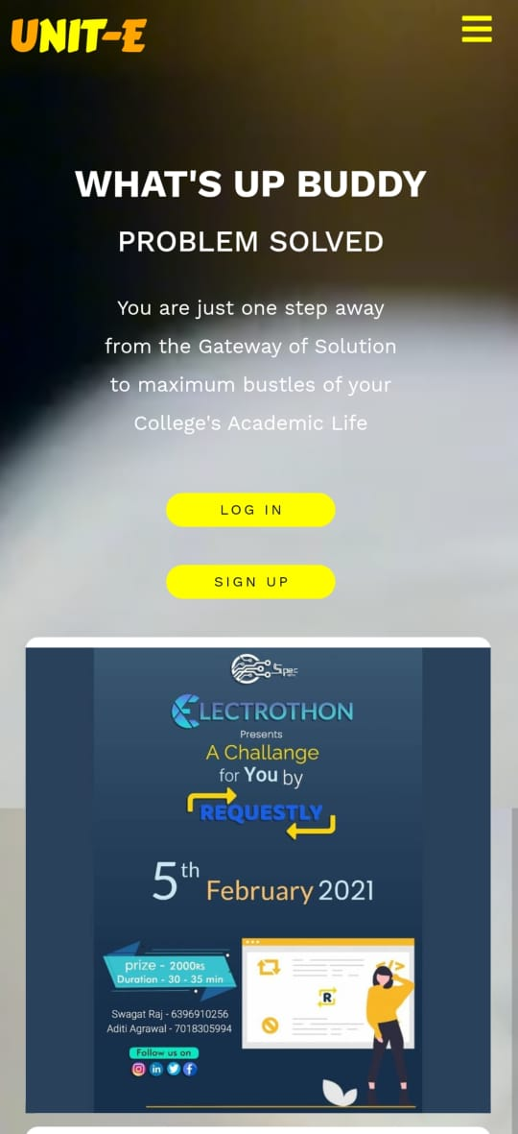
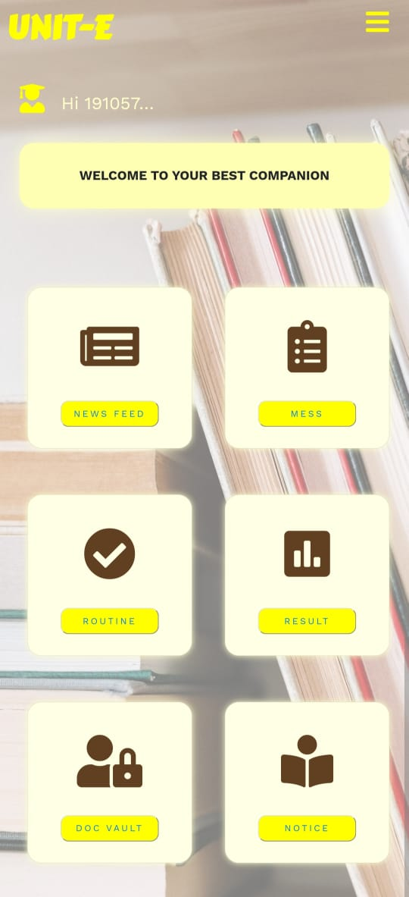
PROGRESS=90%
Home Page
Features

Slide 6
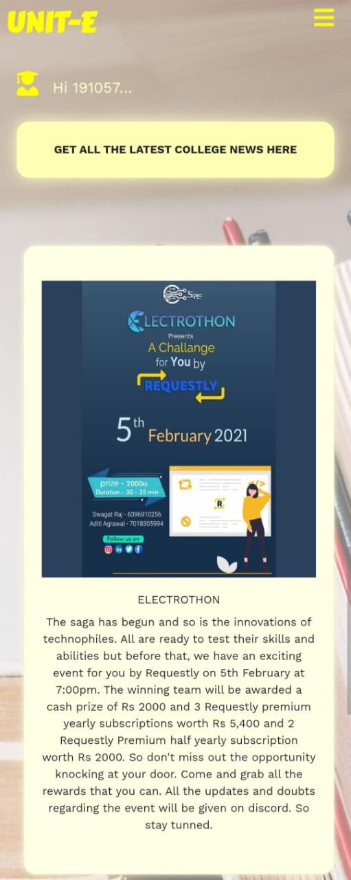
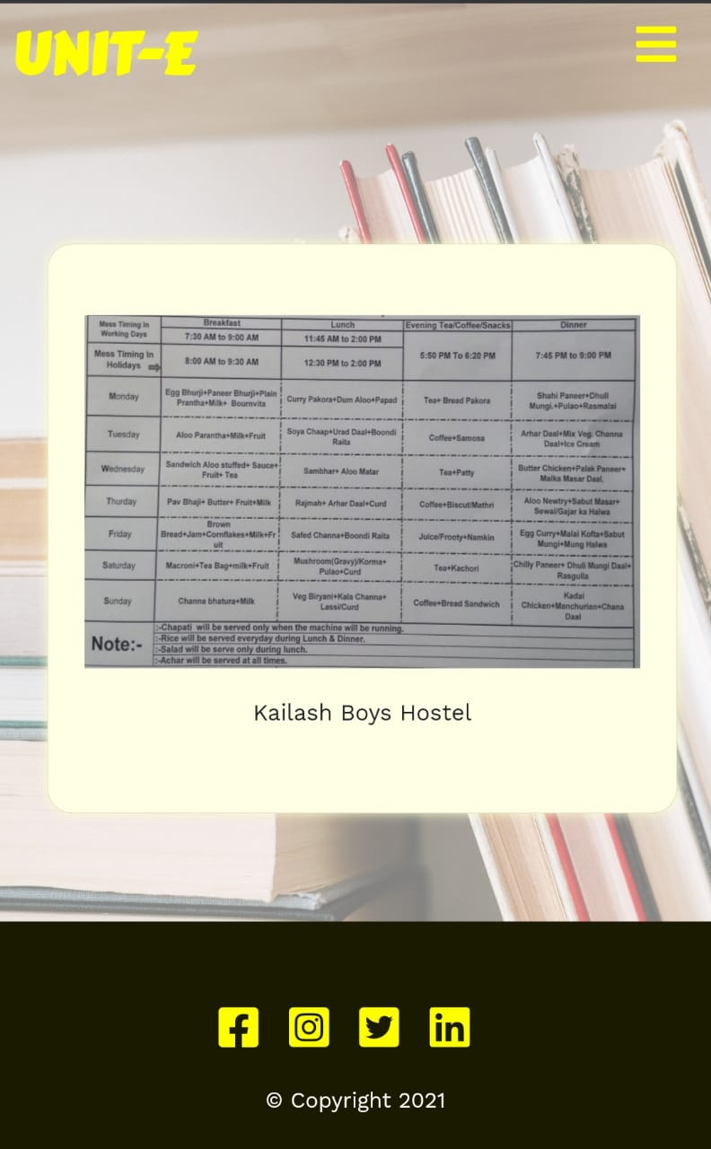
NEWS FEED
MESS ROUTINE

Slide 7
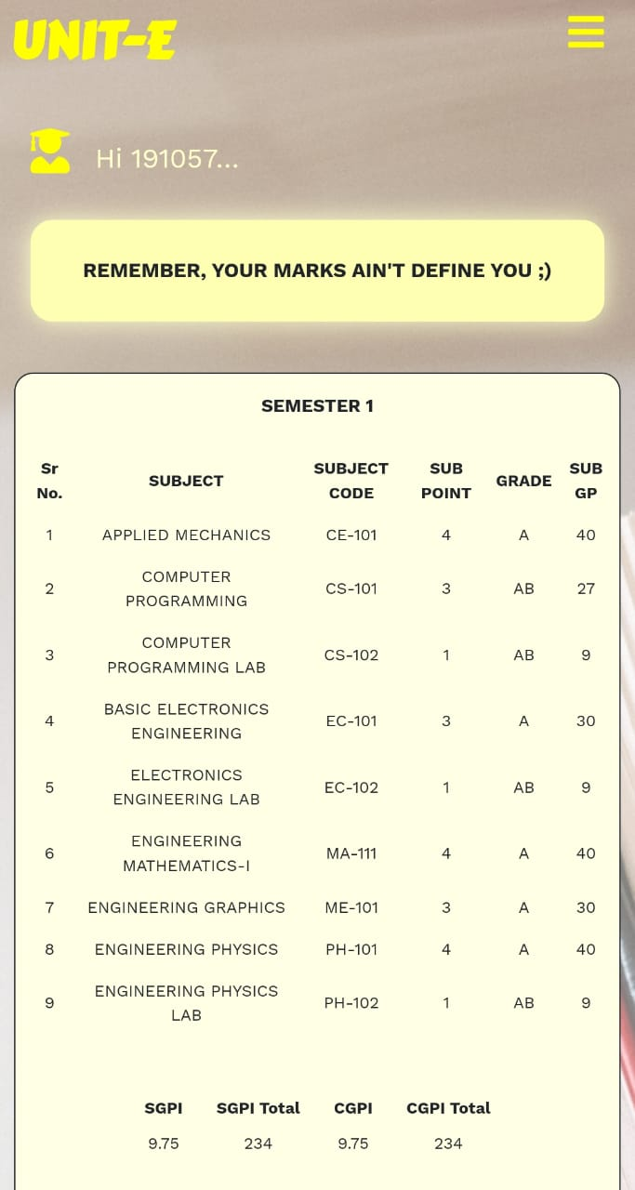
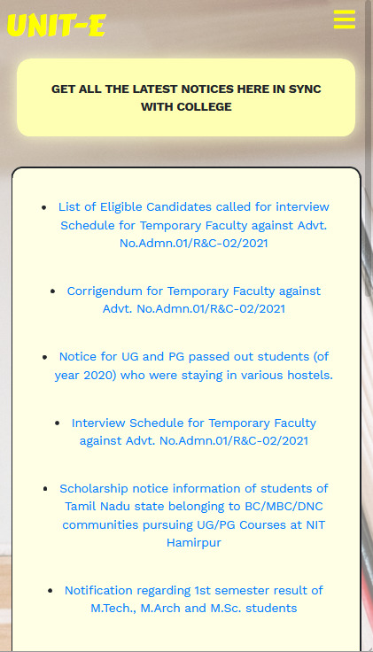
RESULTS
NOTICE

Slide 8
About Team
01
02
Swapnil
Prakhar Pratyush
Developed Frontend of the web app.
Developed Backend of the web app.

